Slide 1


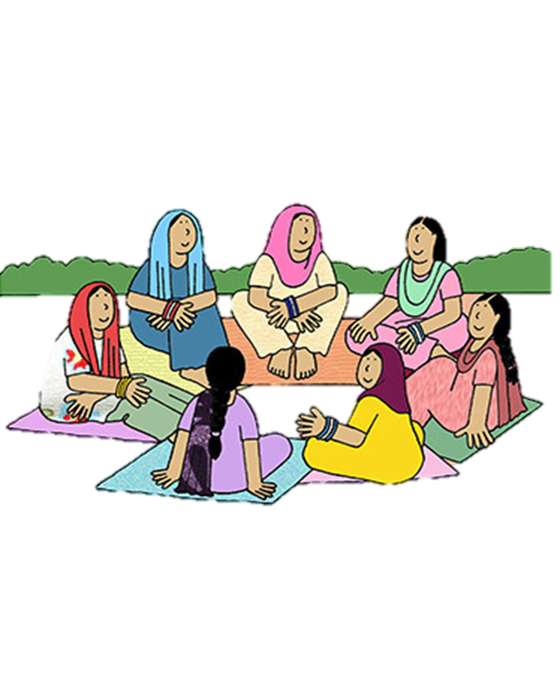


Session-1
Ministry of Rural Development
DAY-NRLM
સત્ર 1
Session-1
Lakhpati Didi Training

Slide 2
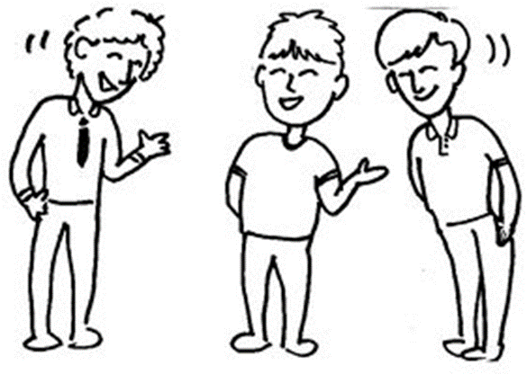

LET US KNOW EACH OTHER

Slide 3

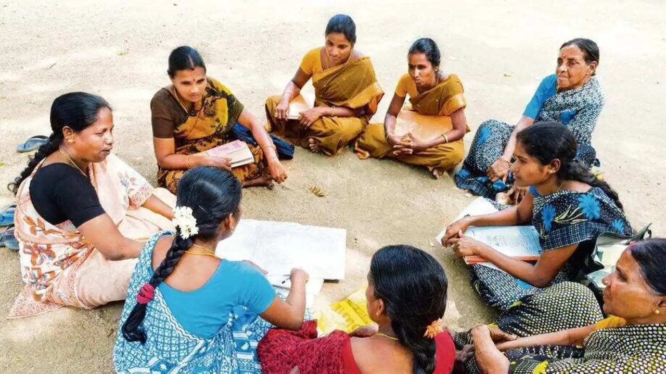


What will we talk about
1.Knowing each other
2.Participants Expectations
3.Training objectives
4.Session plan
5. Training enrolment

Slide 4






POINTERS FOR DISCUSSION
INTRODUCE YOURSELF TO THE GROUP- YOU AS A PERSON AND YOUR WORK
WHAT ARE YOU MOST PROUD OF?
WHAT ARE YOUR EXPECTATIONS FROM THE TRAINING?
10 Minutes

Slide 5

TRAINING OBJECTIVES
1
Orientation on Lakhpati Didi
2
Significance and Role of CRPs and other Stakeholders in making Didis Lakhpati
3
Knowledge and Skill Enhancement of CRPs
for the purpose
•Livelihood Planning and Handholding
•Training & Capacity Building of Didis
•Monitoring

Slide 6


EXPECTATIONS
MENTIONED BY
PARTICIPANTS
EXPECTATION MAPPING

Slide 7

CRP SESSION PLAN
2 Days, 12 Sessions
Concept of Lakhpati Didi
Livelihood and its type (Focus on Lakhpati)
Lakhpati Livelihood Planning
Planning Process at SHG, VO, CLF level and tools for planning
Lakhpati livelihood planning tool- Demo
Roles and responsibilities of Stakeholders
Resource Provisions
Aajeevika Register
Social Security
Group exercise
Orientation of VO/CLF
Valedictory & feedback back

Slide 8

Any questions?

